Slide 1
BITS Pilani
Dr. Lavika Goel
Assistant Professor
Department of CSIS
Pilani Campus

Slide 2
Pilani Campus
Phrase based SMT

Slide 3
Today’s Agenda
Phrase-Based Model
Phrase translation table
Feature functions
Decoding
Pilani Campus

Slide 4
Motivation
Word-Based Models translate words as atomic units
Phrase-Based Models translate phrases as atomic units
Advantages:
  many-to-many translations can be handled by non-compositional phrases
  use of local context in translation
  the more data, the longer phrases can be learned
"Standard Model", used by Google Translate,Microsoft and others
Pilani Campus
Notes:
But words may not be the best candidates for the smallest units for translation.
Sometimes one word in a foreign language translates into two English words, or vice versa.
Word-based models often break down in these cases.

Slide 5
Advantages
Words may not be the best atomic units for translation, due to frequent one-to-many mappings (and vice versa).
Translating word groups instead of single words helps to resolve translation ambiguities.
if we have large training corpora, we can learn longer and longer useful phrases, sometimes even memorize the translation of entire sentences.
Pilani Campus

Slide 6
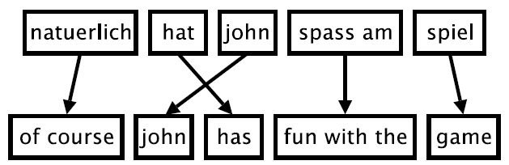
Phrase-Based Model
Six German words
Eight English words
Foreign input is segmented in phrases(Phrase segmentation)
Each phrase is translated into English(Phrase translation)
Phrases are reordered so that the verb follows the subject.(Output ordering)
Pilani Campus

Slide 7
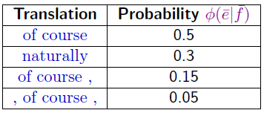
Phrase translation table
Main knowledge source: table with phrase translations and their probabilities
Example: phrase translations for natuerlich
Pilani Campus

Slide 8
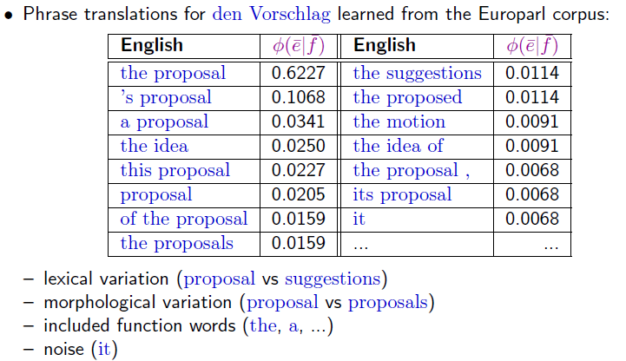
Real Example
Pilani Campus

Slide 9
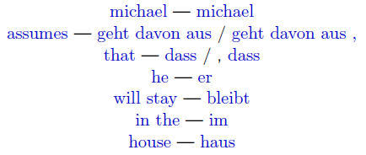
Phrase based Models
First stage in training a phrase based model is extraction of a Phrase-based (PB) lexicon
A PB lexicon pairs strings in one language with strings in other language .e.g.,
English
German
One or more words on either side of the source or target language and number of words
could differ
Pilani Campus
Notes:
These translations form the basis of the translation systems

Slide 10
Example
A training example(E/F sentence pair)
F f1 f2 f3 f4 f5 f6 f7 f8 f9
E Mary did not slap the green witch
(Mary,f1) (did, f2) (not,f2) (slap,f3f4f5) (the,f6f7) (green,f9) (witch,f8)
IBM models
Extract phrase pairs from the above alignment
Run some algorithm on
each of the parallel sentences
Extract phrase pairs
E
F
Pilani Campus

Slide 11
Alignment Matrix
FOREIGN
 | f1 | f2 | f3 | f4 | f5 | f6 | f7 | f8 | f9
Mary
did
Not
Slap
the
green
witch
E
N
G
L
I
S
h
Each foreign word is aligned to exactly one English word observe that there is
One single dot in each column
Pilani Campus

Slide 12
Issues with the alignments
Alignments contain noise or they are erroneous.
Many to one (i.e each word in Foreign language is aligned to one word in English).This constraint is not realistic
Pilani Campus

Slide 13
Finding alignment matrices
Step 1: Train IBM Model for P(f|e) and come with the most likely alignment for each (e,f) pair.
Step 2: Train IBM Model for P(e|f) and come with the most likely alignment for each (e,f) pair.
We now have two alignments: take union of the two alignments as a starting point.
Pilani Campus

Slide 14
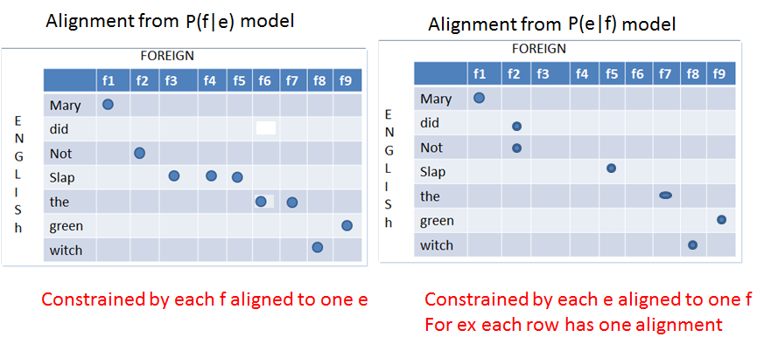
union of alignment
Pilani Campus

Slide 15
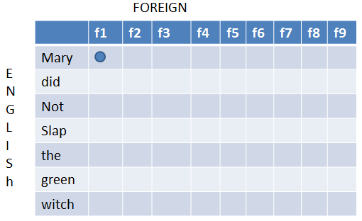



Extracting phrase pairs from the alignment matrix
A phrase pair consist of a sequence of English words e, paired with a sequence of foreign words,f.
A phrase pair (e,f) is consistent if
1) Every word in e is aligned to atleast one word in f
2)There are no words in f aligned to words outside
3) There are no words in e aligned to words outside f
(Mary did not,f1,f2) is consistent
(Mary did,f2) is not consistent
We extract all consistent phrase
pairs for the training example.
Pilani Campus
Notes:
Extract all possible phrase pairs that are consistent with alignment
How to check if a phrase pairs are consistent with alignments?
Mary did not, f1,f2
No alignment points in rows corresponds to 3
No alignment points in colunmns corresponds to 2

Slide 16
Probabilities for Phrase Pairs
For any phrase pair(f,e) extracted from the training data, we can calculate
t(f|e) = count(f,e) / count e
e.g.,
t(f3,f4,f5|slap) = count(f3 f4 f5)/count(slap)
Pilani Campus

Slide 17
Pilani Campus
Phrase based translation model

Slide 18
Mathematical Definition
The phrase translation model is based on the noisy channel model.
We use Bayes rule to reformulate the translation probability for translating a foreign sentence f into English e as p(e|f)
argmax_{e} p(e|f) = argmax_{e} p(f|e) p(e)
This allows for a translation model p(f|e) and a separate language model p(e).
This is exactly the same reformulation that we have already seen for word-based models.
Pilani Campus

Slide 19
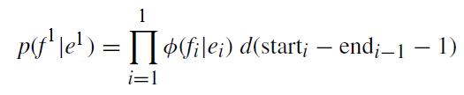

Mathematical Definition(Contd..)
We decompose p(f|e) further into
Invert the translation direction
Pilani Campus

Slide 20
Learning a Phrase Translation Table
Power of phrase-based translation rests on a good phrase translation table.
Task: learn the model from a parallel corpus
Three stages:
  word alignment: using IBM models or other method
  extraction of phrase pairs
  scoring phrase pairs
Pilani Campus

Slide 21
Mathematical Definition(Contd..)
Reordering is handled by a distance-based reordering model.
Reordering relative to the previous phrase
Pilani Campus

Slide 22
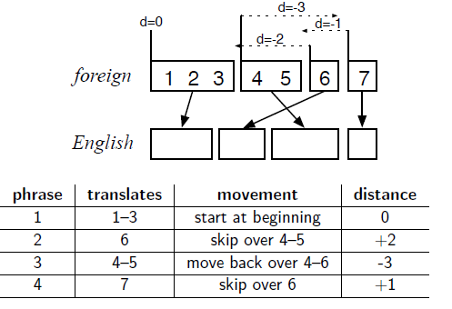
Distance-Based Reordering
distance = start_{i} − end_{i−1} − 1
Reordering distance is measured on the foreign input side.
Dashed arrow indicating the extent of reordering.
For instance the 2nd English phrase translates the foreign word 6, skipping over the words 4–5, a distance of +2.
Pilani Campus
Notes:
In order to generate
phrase1 in english reordering distance = 1-0-1=0
phrase2 in english reordering distance = 6-3-1=2
phrase3 in english reordering distance = 4-6-1=-3
phrase4 in english reordering distance = 7-5-1=1

Slide 23



Distortion Probability:
Distance-based reordering
Reordering distance: how many words were skipped (either forward or backward) when generating the next foreign word.
  start_{i}: the word index of the first word of the foreign phrase that translates the ith English phrase
  end_{i}: the word index of the last word of the foreign phrase that translates the ith English phrase
  Reordering distance = start_{i}-end_{i-1}-1
What is the probability that a phrase in the English sentence skips over x foreign words in the foreign sentence?
Two words in sequence: start_{i}=end_{i-1}+1, so distance=0.
How are d probabilities computed?
  Exponentially decaying cost function:
  Where
  Scoring function: d(x) = α^{|x|} – exponential with distance
Pilani Campus
Notes:
instead of estimating the reordering probability from data as well, the reordering is handled by a pre-defined model: an exponentially decaying cost function: d(x) = α ^{|x|} , in this case: d = α ^{|starti−endi−1−1)|} with a value for the parameter α ∈ [0, 1]

Slide 24
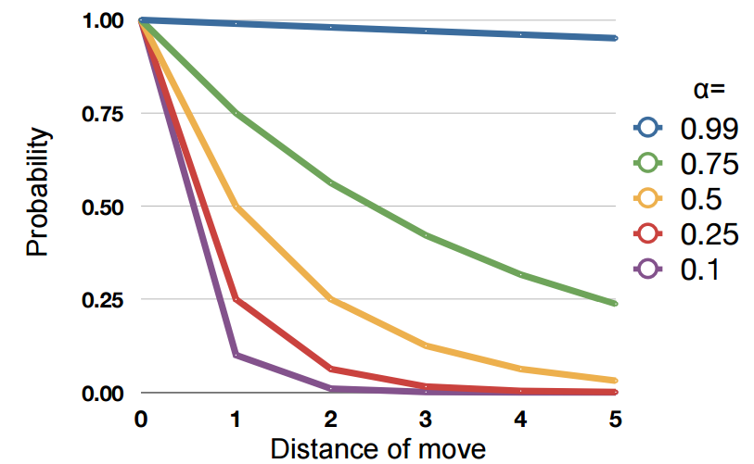
Values of α
Pilani Campus

Slide 25
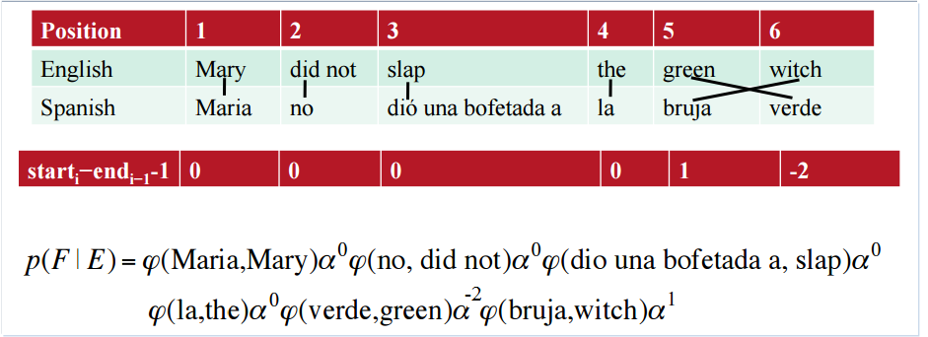
Example for the Translation Model
Pilani Campus

Slide 26
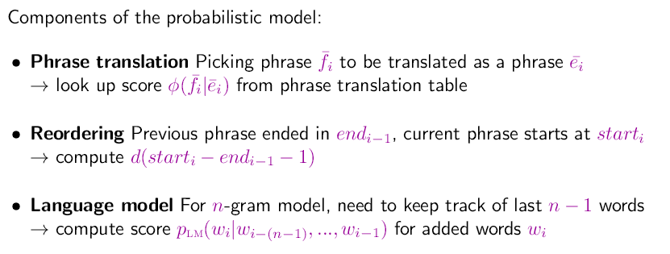

Computing Translation Probability
Pilani Campus
Notes:
there are three components that contribute to producing the best possible translation, by ensuring that
• the foreign phrases match the English words (φ);
• phrases are reordered appropriately (d);
• the output is fluent English (pLM).

Slide 27


Log-Linear Models
We may observe that the words between input and output match up pretty well, but that the output is not very good English.
Hence we can think of giving more weight to the language model.
Introducing weights to each of these components
Pilani Campus
Notes:
Even this relatively simple version achieves generally better translation quality than the word-based statistical IBM models. We will extend the model, achieving further improvement of translation performance.

Slide 28
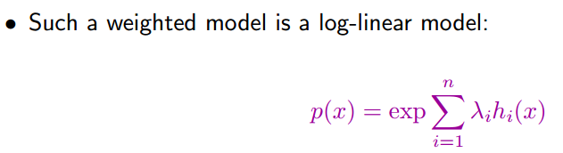
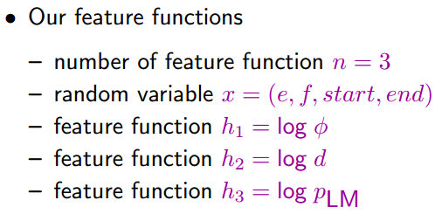
Log-linear models
Pilani Campus

Slide 29
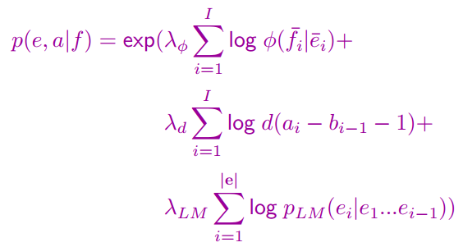
Weighted Model as Log-Linear Model
Pilani Campus

Slide 30
Summary
Phrase based SMT consider phrases as atomic units.
Phrase based translation table is built using the parallel corpus.
Use IBM model 1 to find the best alignment for each f,e sentence pairs.
Represent the alignment in the form a matrix.
Extract phrase pairs that are consistent with alignment.
Calculate the probability of translating each phrase pair.
Pilani Campus

